Slide 1
Case Study: Buggy Food Delivery App
Testing Failure Demonstration

Slide 2
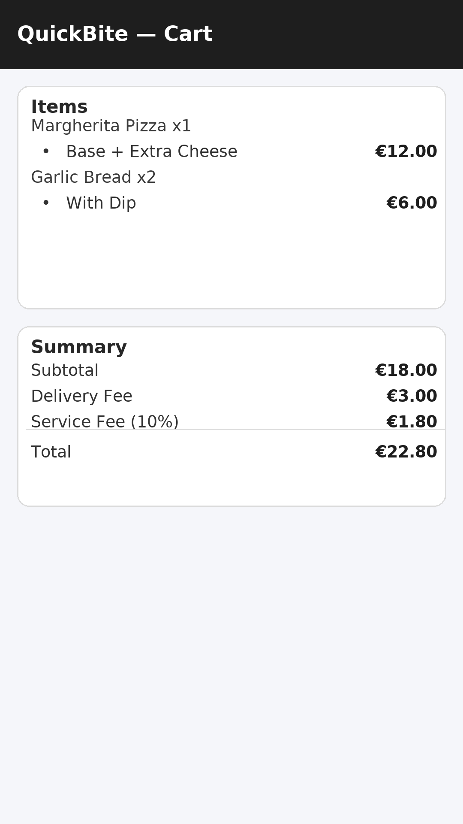
Cart Screen (Correct Total)
Items & fees displayed correctly
Total = €22.80 (as expected)
Notes:
Show this screen first. Explain that everything seems fine at the cart stage.

Slide 3
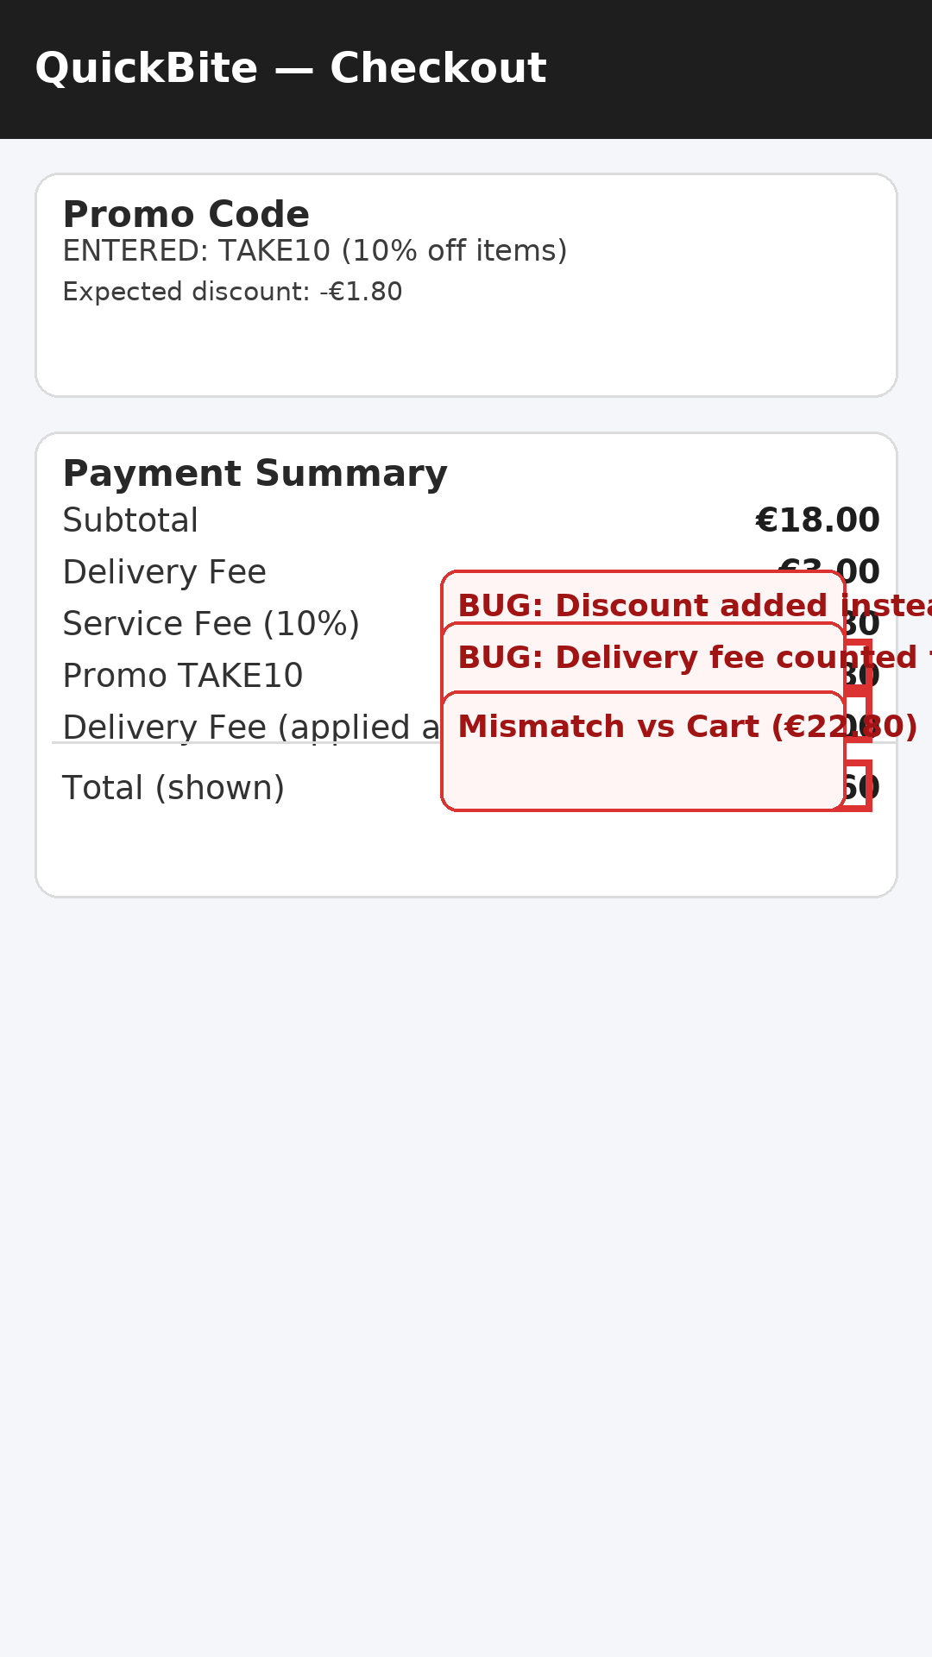
Checkout Screen (Buggy)
Promo discount applied incorrectly (+ instead of -)
Delivery fee counted twice
Total = €27.60 (mismatch vs cart €22.80)
Notes:
Highlight the two clear bugs: discount error and duplicate delivery fee. Ask students what type of testing might catch these issues (UI, API, integration tests).

Slide 4
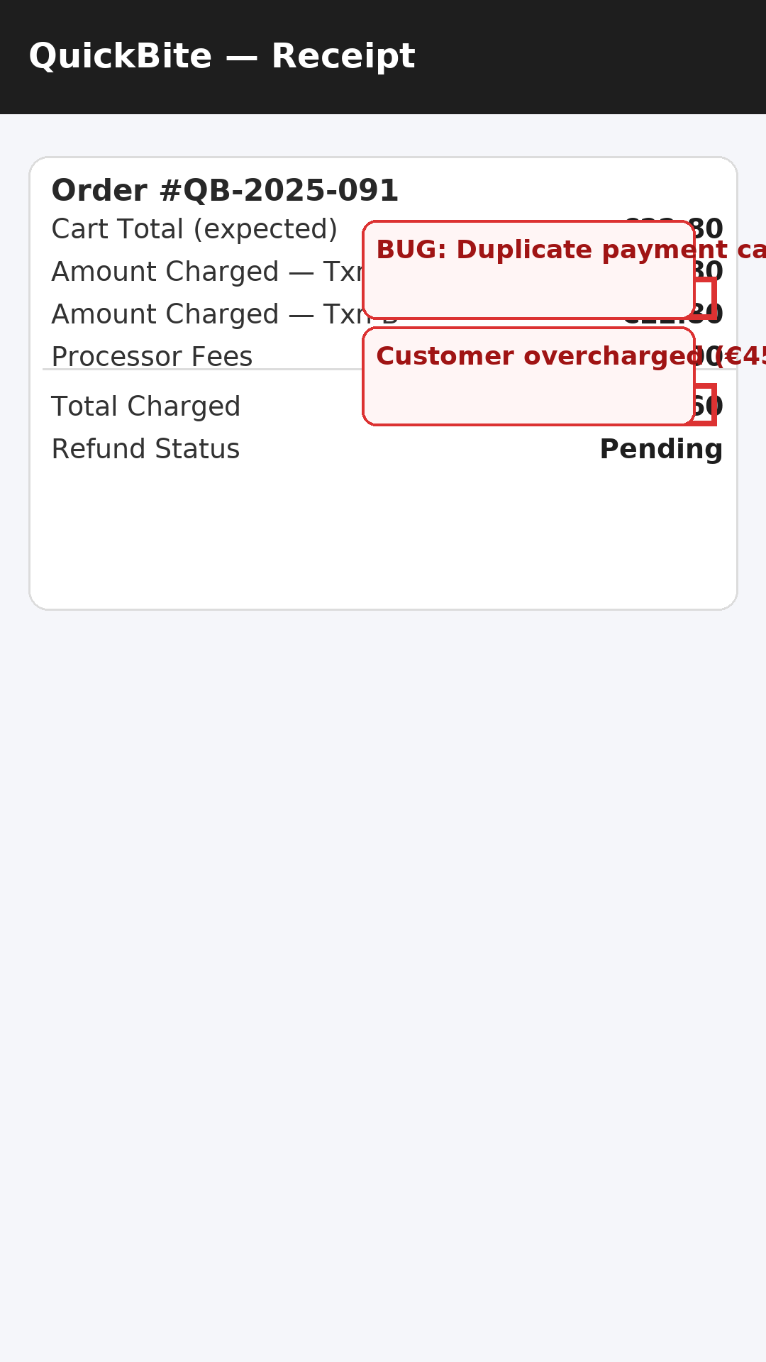
Receipt Screen (Buggy)
Duplicate transaction captured
Customer charged €45.60 instead of €22.80
Refund still pending
Notes:
Demonstrate how bugs at checkout/payment integration can cause serious customer impact. Discuss how logs and monitoring can help catch such issues early.

